Slide 1
Visualizing Trends & Distributions with ggplot2
Anthro-Data-Science Working Group
By: Monica Keith, Shane Scaggs, Delaney Glass, & Li-Ying Wang

Slide 2


Slide 3
Our Website: https://anthro-data-science.github.io/
Materials for today: https://github.com/anthro-data-science/data-viz-pt2
Join our low-volume mailing list:
https://groups.google.com/u/2/g/anthro-data-science

Slide 4
Today’s workshop
Data visualization guidelines for scientific publications
Plotting data distributions and trends with ggplot
Ordered bar graph
Heatmap
Density contour plot
Scatter plot with trend line
Violin plot
Forest plot
Alluvial plot
Plot customizations
Custom theme
Colors
Axis labels, scales
Annotations
Remove/edit/position legend
Data manipulation and tabulation
Saving plots as image files
Links to additional resources

Slide 5
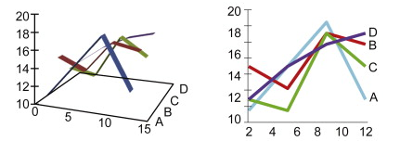
Guidelines for effective data visualization in scientific publications (Kelleher & Wagener, 2011)
Create the simplest graph that communicates your information
Choose form and encoding attributes that maximize audience perception
People generally perceive length and position (2D) better than color, area, line width, etc. (Cleveland & McGill, 1984)

Slide 6
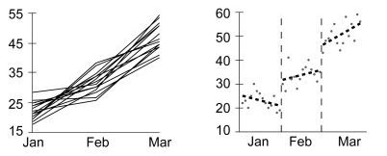
Guidelines for effective data visualization in scientific publications (Kelleher & Wagener, 2011)
Focus on visualizing either general patterns or quantitative details
Use detail plots (e.g. histogram, line graph) when individual values are important
Use pattern plots (e.g. heatmap, area chart) to show general trends
Aggregate larger datasets in meaningful ways

Slide 7
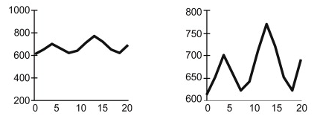
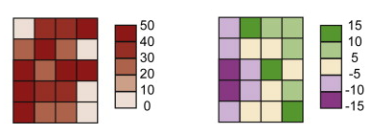
Guidelines for effective data visualization in scientific publications (Kelleher & Wagener, 2011)
Select meaningful axis ranges
Scales impact visualizations of relative magnitudes and relationships
Maintain consistent axis ranges across subplots
Use an appropriate color scheme for your type of data
Contrasting colors for categorical data
Sequential gradients for quantitative data
Diverging schemes to differentiate average and extreme values

Slide 8
Load your package and data
library(tidyverse)
data(“starwars”)

Slide 9
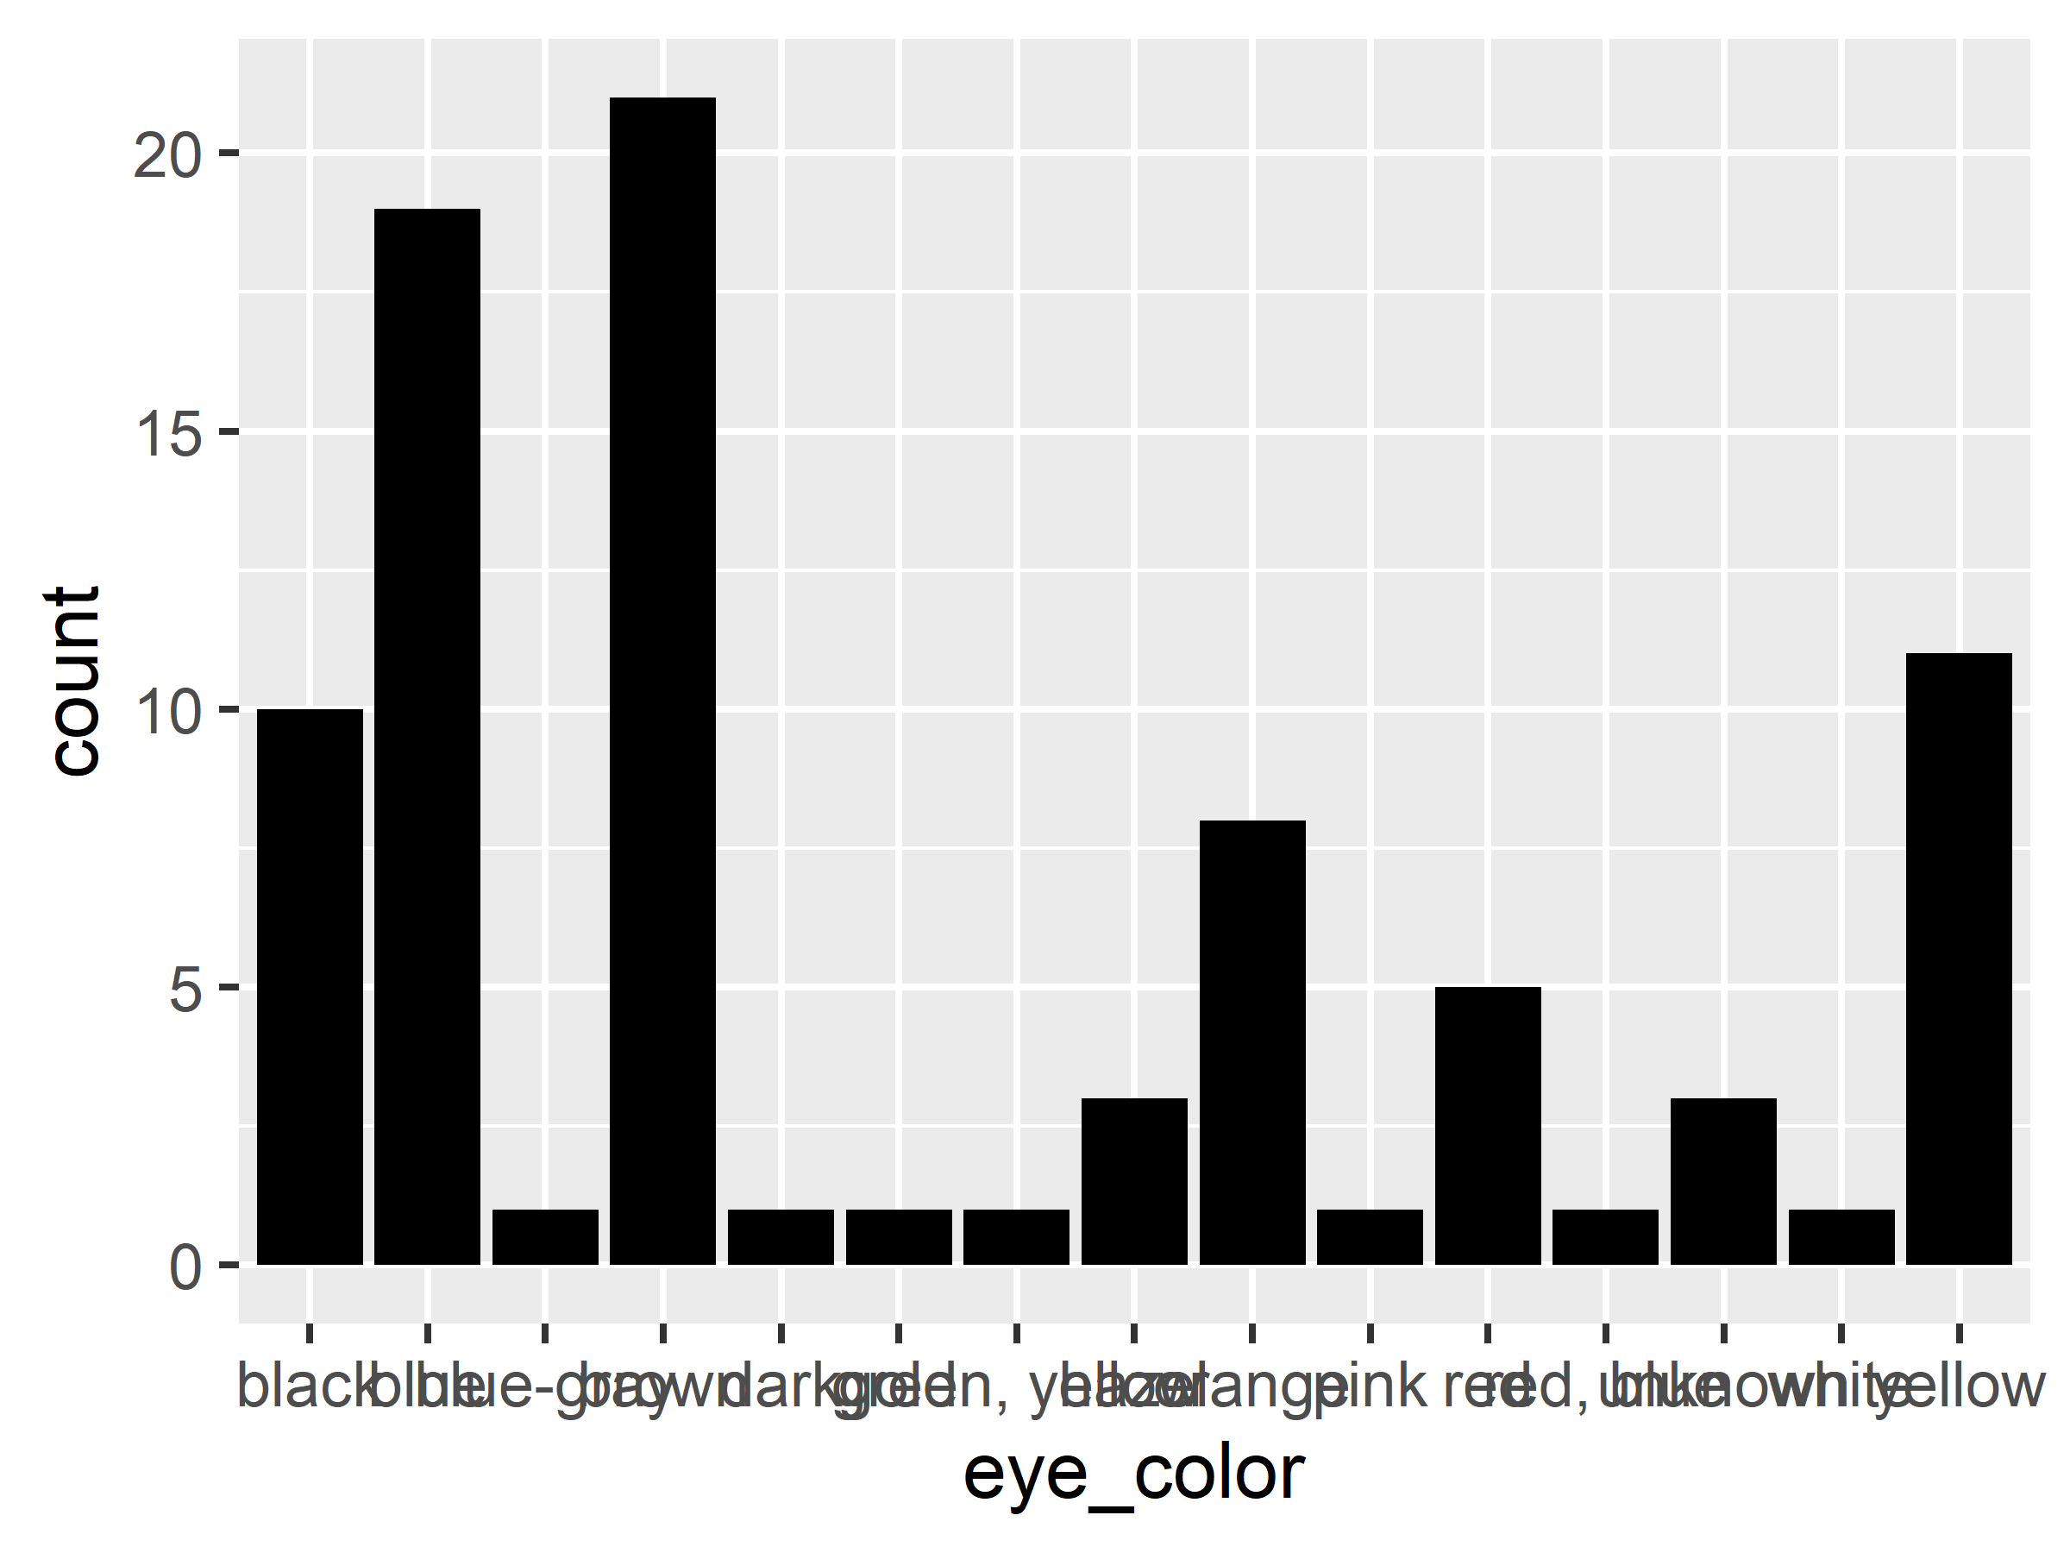
Basic bar graph
starwars %>%
ggplot( aes( x=eye_color )) +
geom_bar( fill='black' )
Notes:
This is a mess! We need to clean it up!

Slide 10
Custom theme
my_theme <- theme(
panel.background = element_rect(color='black', fill='white'),
panel.grid = element_line(color='gray90'),
panel.grid.major.y = element_blank(),
panel.grid.minor.x = element_line(linetype=2)
)
Notes:
The parts of a theme are specified using different `elements` that have their own aesthetic parameters:
element_rect
element_line
element_grob
element_render
element_text
element_blank (for removing an element)
Most questions can be answered by calling ?theme

Slide 11
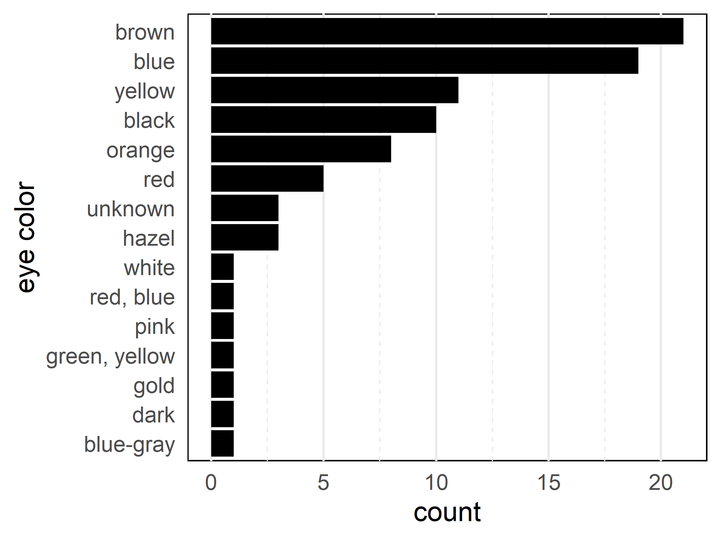
Ordered bar graph +
custom theme
starwars %>%
ggplot( aes( x=reorder(eye_color,
eye_color,
FUN=length ))) +
geom_bar( fill='black' ) +
theme_minimal() +
coord_flip( ) +
my_theme +
labs( x='eye color')

Slide 12
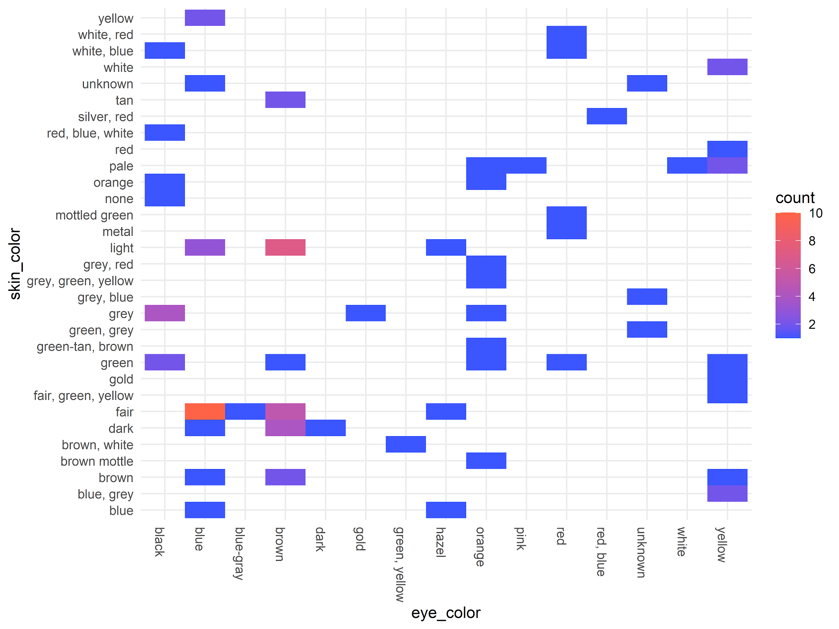
Two discrete variables with geom_bin2d
starwars %>%
ggplot( aes( eye_color, skin_color ))+
geom_bin2d() +
theme_minimal() +
theme( axis.text.x = element_text(
angle=-90,
hjust=0
)) +
scale_fill_continuous(
breaks = seq(0,10,2),
low = '#3B55FF',
high = 'tomato'
)

Slide 13
bin2d works best with ordinal variables, but we need to make some
starwars$ord_mass <- with(starwars,
cut(mass,
breaks=quantile(mass,
breaks=seq(0,1,length.out=5),
na.rm=TRUE),
include.lowest=TRUE,
labels=c(1,2,3,4)))
starwars$ord_height <- with(starwars,
cut(height,
breaks=quantile(height,
breaks=seq(0,1,length.out=5),
na.rm=TRUE),
include.lowest=TRUE,
labels=c(1,2,3,4)))

Slide 14
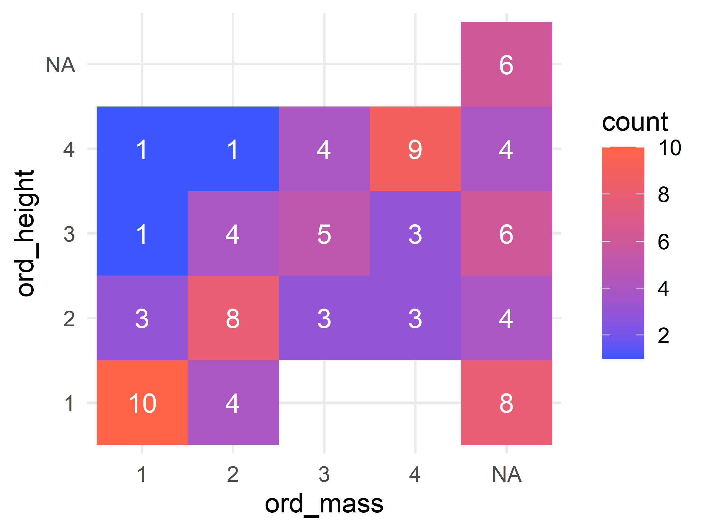
Two ordinal variables with bin2d
starwars %>%
ggplot( aes( ord_mass, ord_height )) +
geom_bin2d( binwidth=1 ) +
theme_minimal( ) +
scale_fill_continuous( breaks = seq(0,10,2),
low='#3b55ff', high='tomato') +
stat_bin2d( geom='text', aes( label = ..count..),
binwidth = 1, color='white')

Slide 15
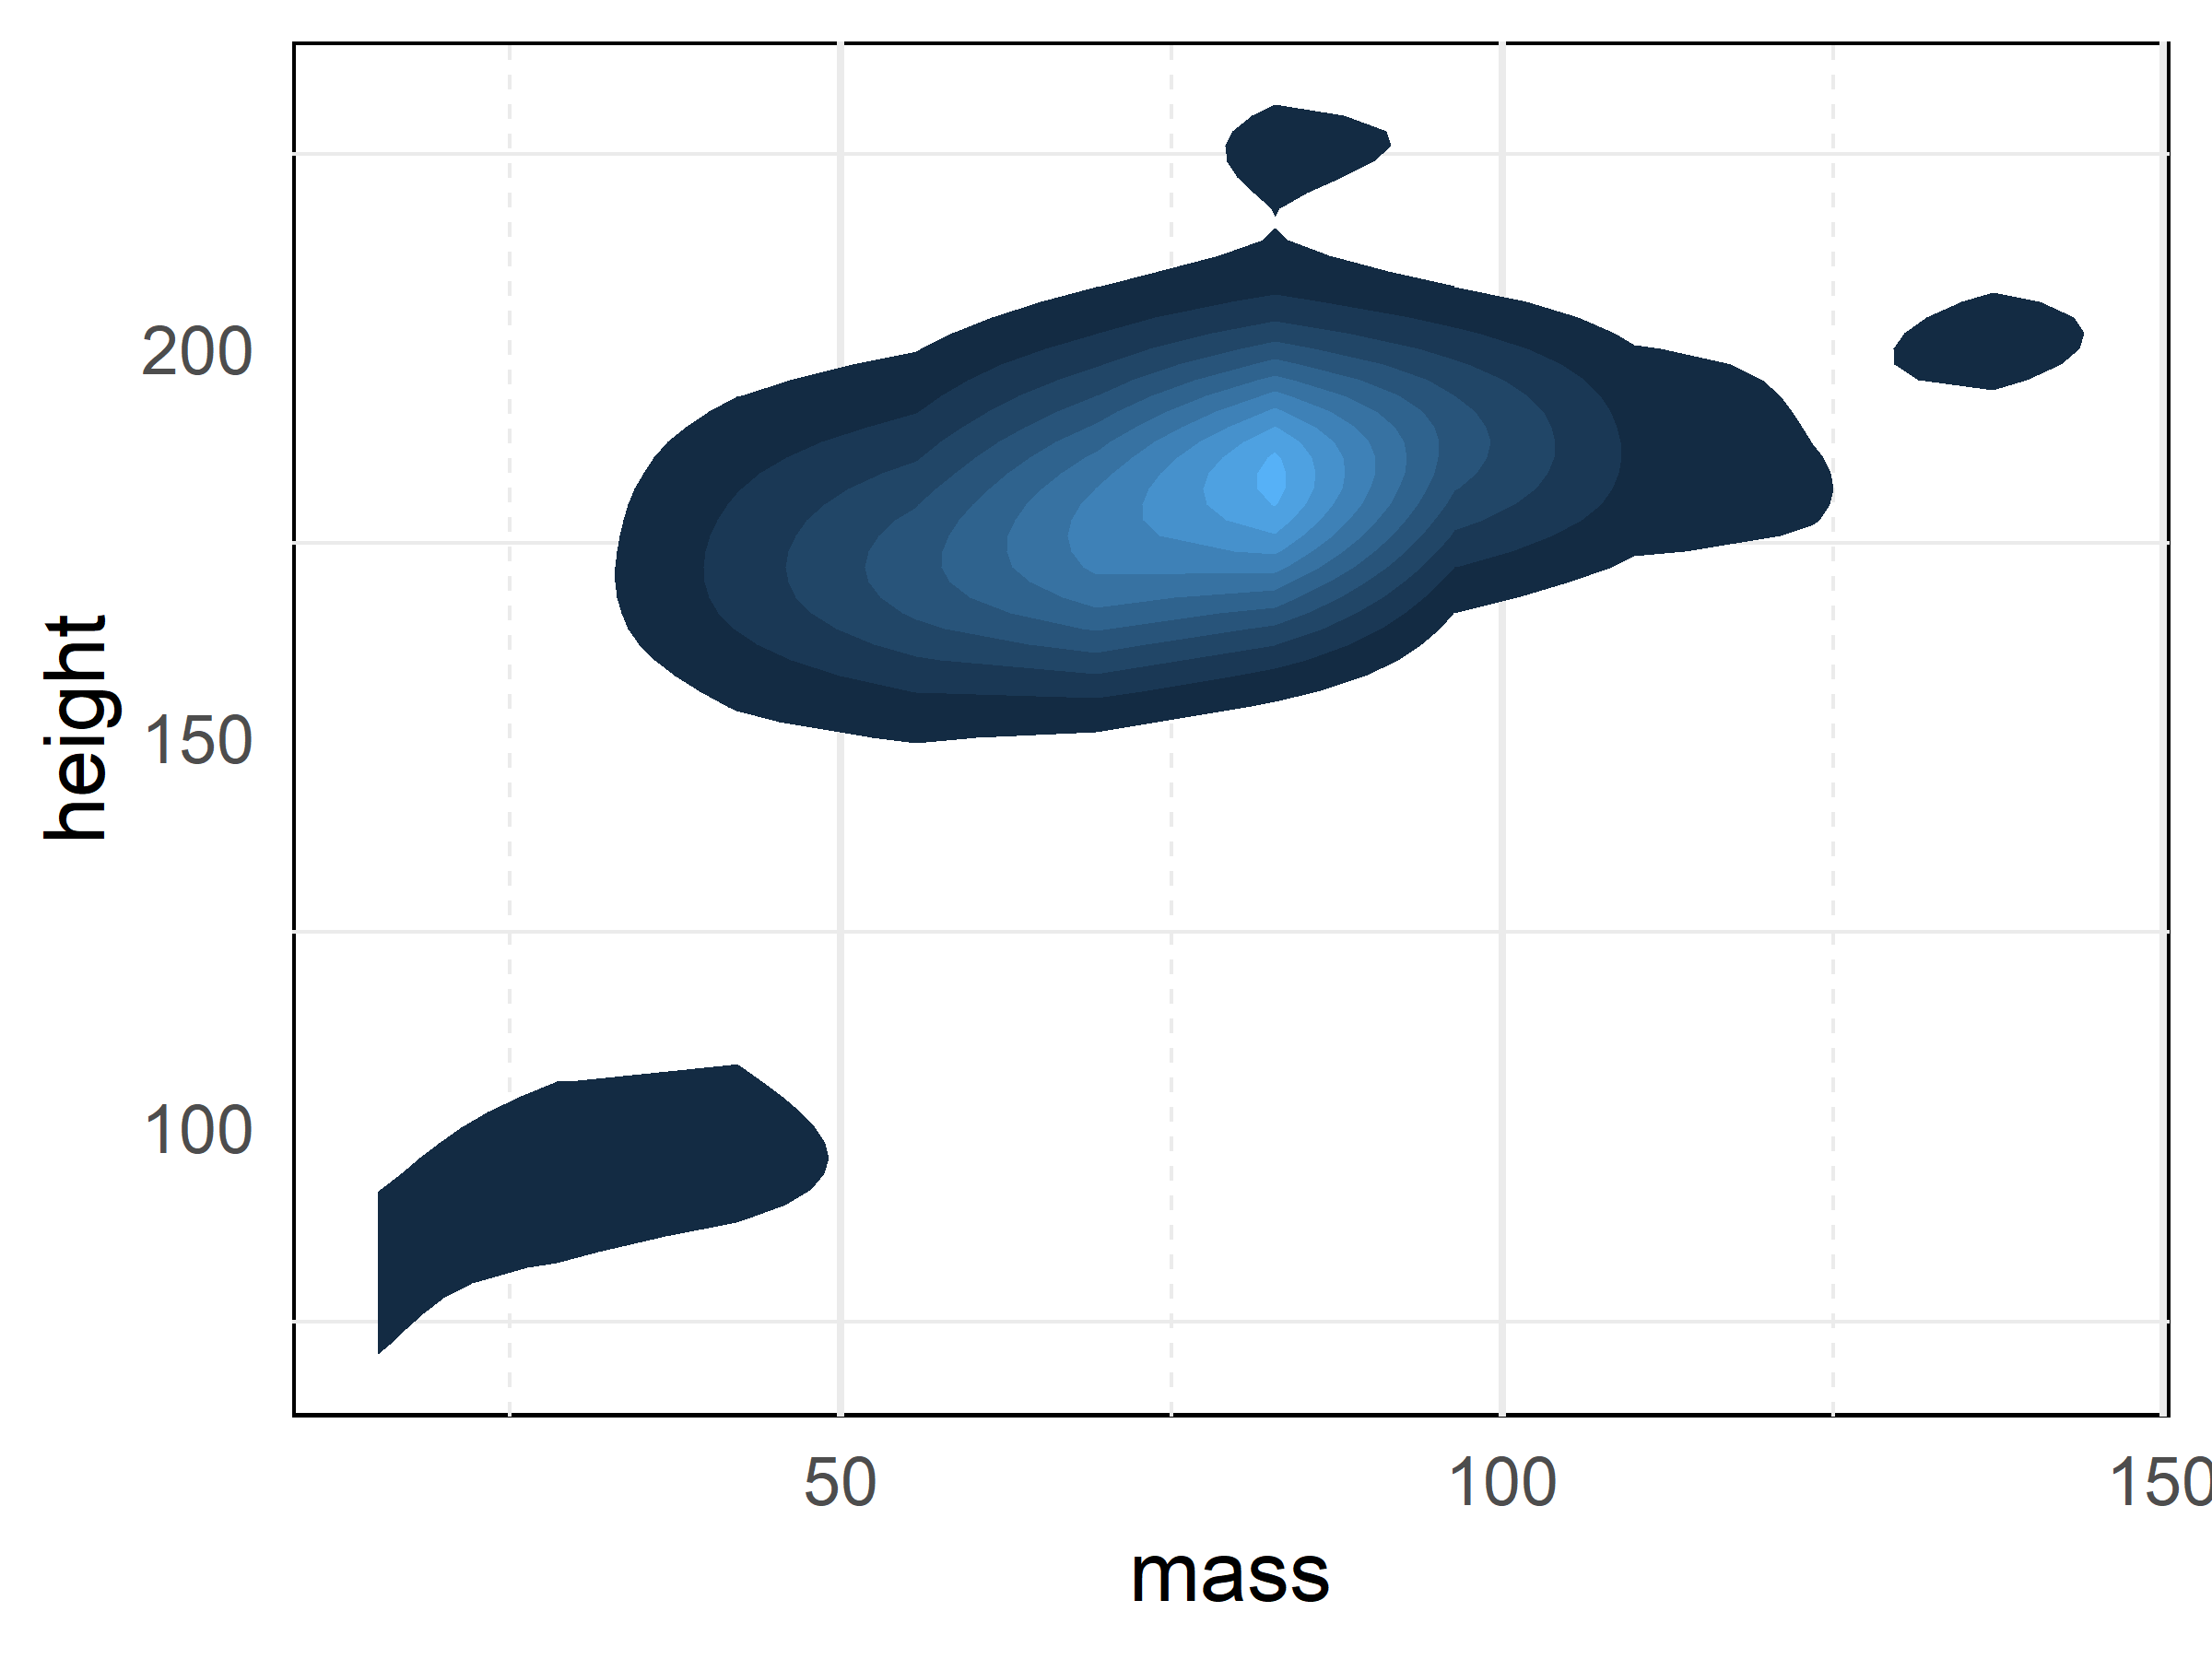
Two continuous variables: contours
starwars %>%
ggplot( aes(mass, height )) +
stat_density_2d( aes(fill = ..level..),
geom = "polygon") +
theme_minimal() +
theme( legend.position = 'none' ) +
my_theme
Notes:
An alternative to a scatterplot that will handle outliers for you based on the stat that you have chosen.

Slide 16
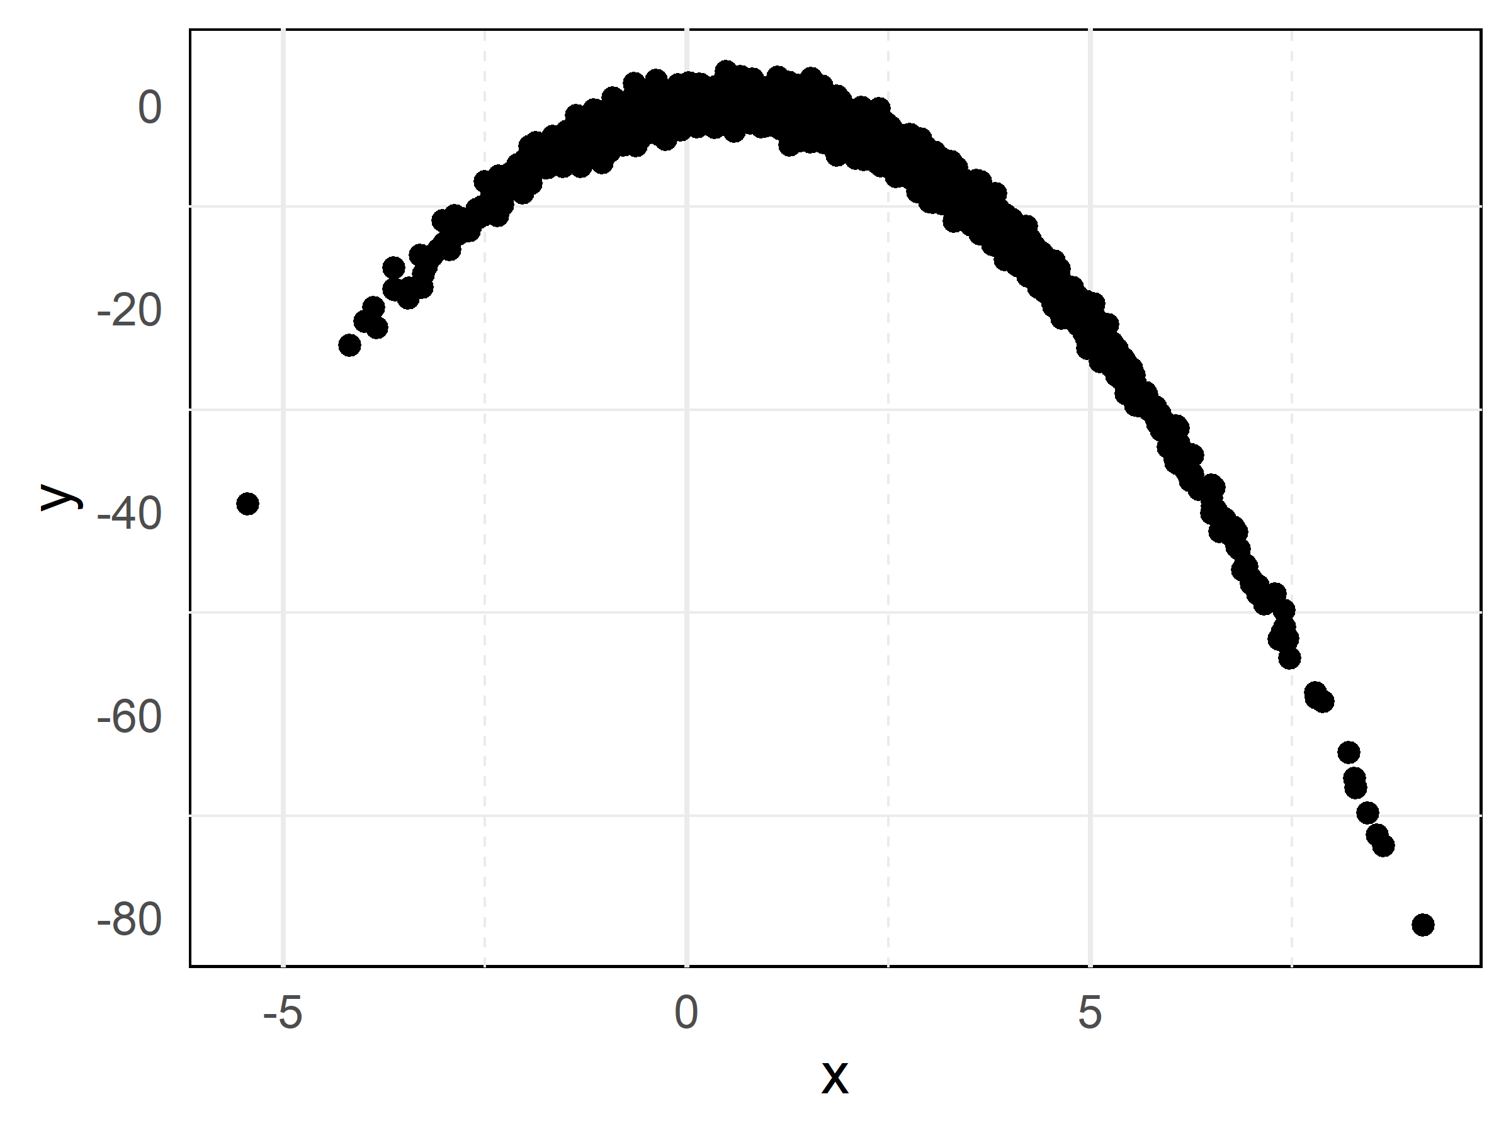
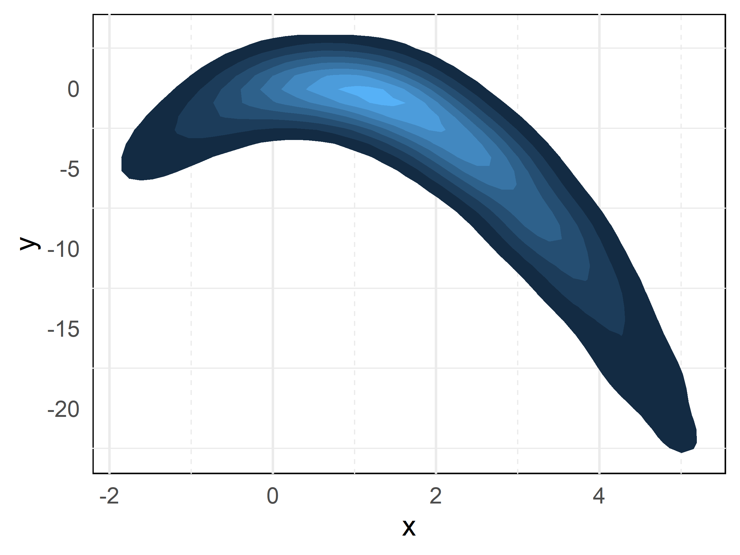
Useful when you have a lot of data
set.seed(777)
N <- 3000
R <- 1.1
x <- rnorm(N, 2, 2)
y <- R*x*(1-x) + rnorm(N,0,1)
d <- data.frame(x,y)
dim(d)
[1] 3000 2
head(d)
x y
1 2.979572 -6.163316
2 1.202917 -2.029641
3 3.021673 -9.233758
4 1.202376 1.368988
5 5.277372 -24.563343
6 3.242548 -8.310549

Slide 17
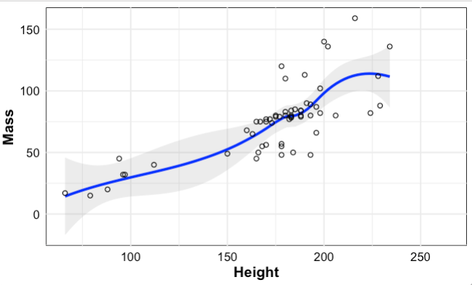
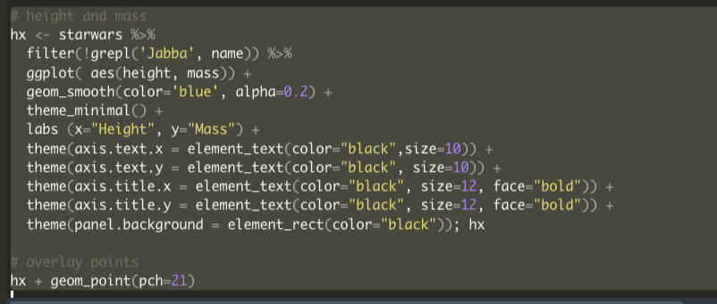
Scatter Plot with trend-line and overlay
Scatter of height and mass

Slide 18
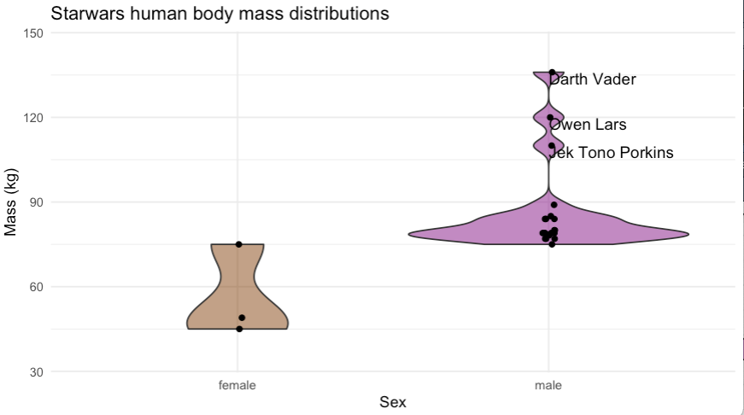
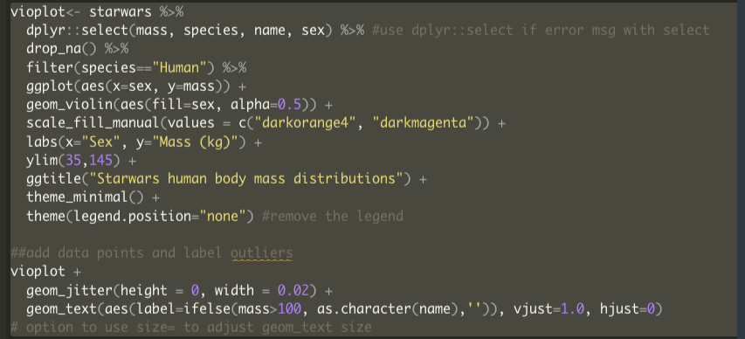
Violin Plot with overlay and annotated outliers
body mass distributions of human Starwars characters by sex

Slide 19
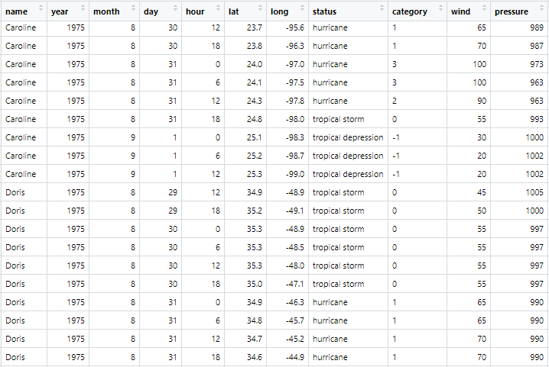
“storms” data
Repeated observations
Storm status/category fluctuates with wind speed
Tropical storm names repeat every 6 years

Slide 20
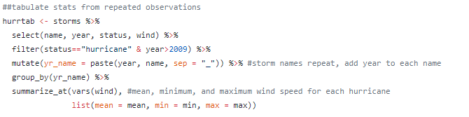
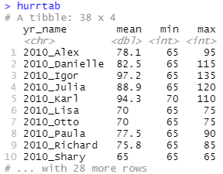
Forest plot Hurricane wind averages and ranges 2010-2015

Slide 21
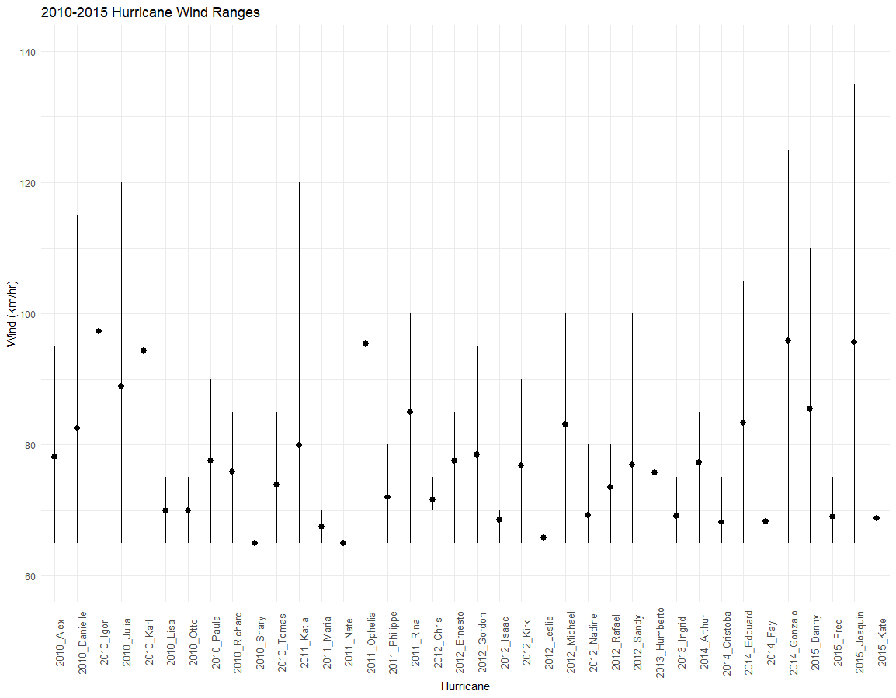
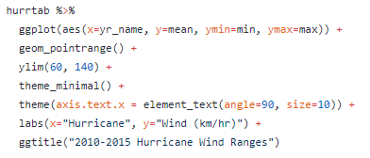
Forest plot Hurricane wind averages and ranges 2010-2015

Slide 22
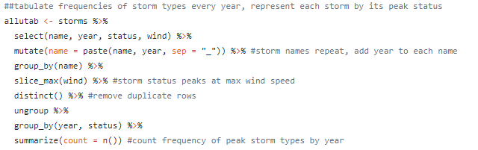
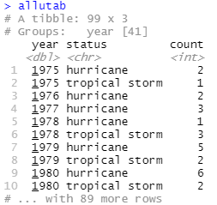
Alluvial plot Trends in tropical storm frequencies 1975-2015

Slide 23
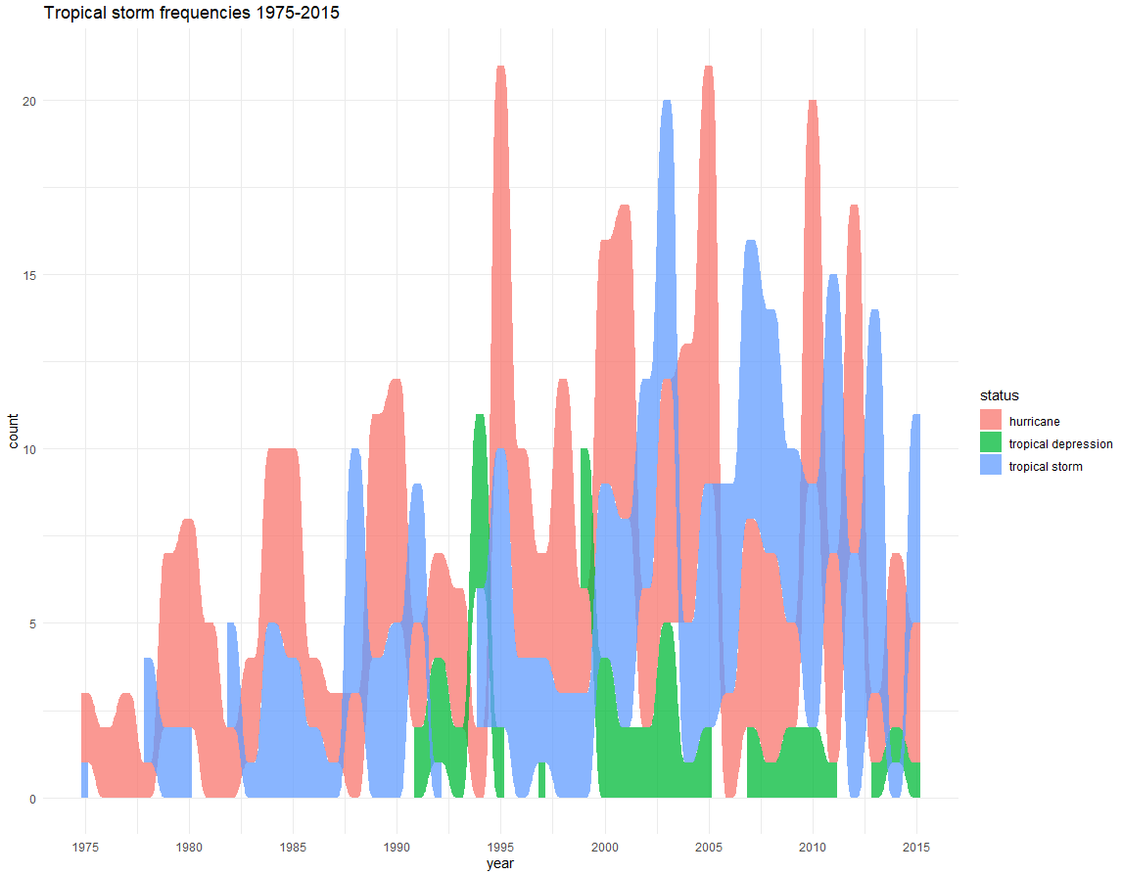
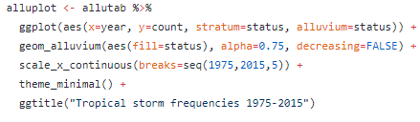
Alluvial plot Trends in tropical storm frequencies 1975-2015

Slide 24
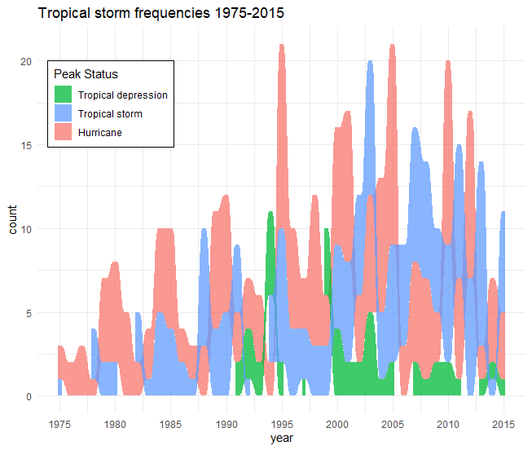
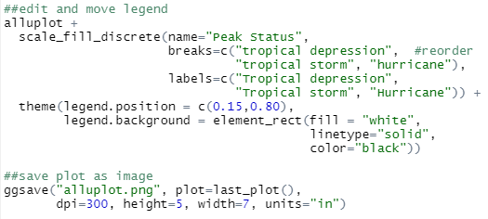
Alluvial plot Trends in tropical storm frequencies 1975-2015

Slide 25
Some stellar ggplot2 resources
The R Graph Gallery - Hundreds of example graphs
Plotly w/ ggplot2 - Make your ggplot2 graphs interactive!
Cédric Scherer’s ggplot2 tutorial - ~180 graphs, lots of gg extension packages (e.g. ggrepel)
Color in ggplot2 and R - including colorblind friendly considerations
Google Dataset Search - Search for open access datasets of all kinds
R for Data Science - Hadley Wickham & Garrett Grolemund

Slide 26
Example-
Interactive plot

Slide 27
Thank you for joining us!
Stay in touch!
https://anthro-data-science.github.io/
@ShaneAScaggs
@LiyingWang10
@Gayoung_FS_Park
@GlassDelaney
@Benmarwick

